Slide 1
Ellen Lull Case Study 2 Data Visualization / Section 403

Slide 2
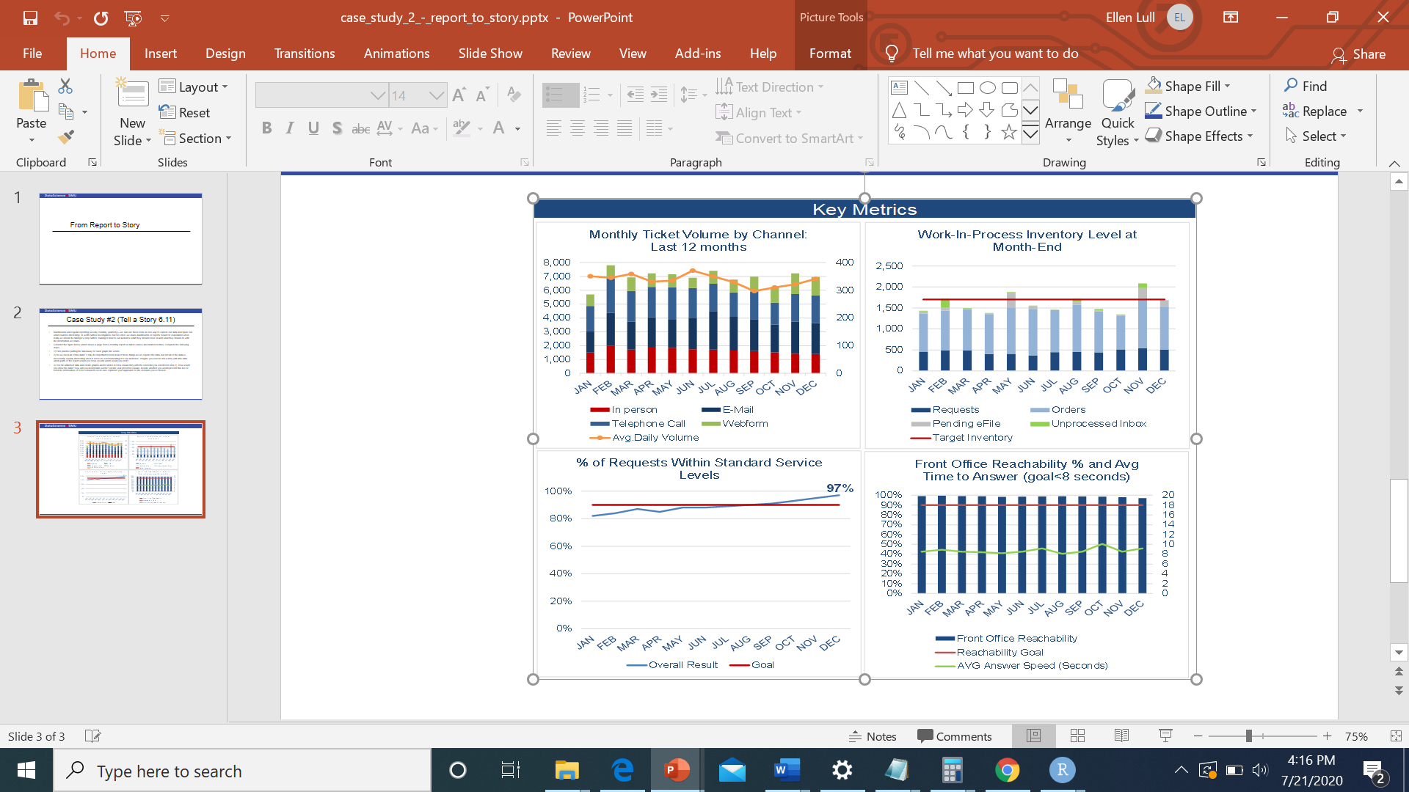
Question 1:
Putting the takeaway for each graph into words
The graph below is showing the ticket volume by channel. It is showing that later in the year the number of webform submitted tickets increased
The graph below is showing the work in progress and what phase of the process the work is currently in
The graph below is showing 2 different/unrelated items. The reachability percentage versus it’s goal and the average time to answer versus its goal
The graph below is showing the percentage of tickets that made the service goal of 90 percent.

Slide 3
Question 2:
Do we need all of this data? It may be important to look at all of these things as we explore the data, but not all of the data is necessarily equally interesting when it comes to communicating it to our audience. Imagine you need to tell a story with this data: which parts of the report would you focus on and which would you omit?
Ticket volume by channel: We do not need all this data. The daily trend overlaying the actual tickets by channel is distracting and not very useful. The trends are covered with the other data. The daily scale on the left y-axis is also not useful and confusing. The stacked bars are hard to use in determining the amount of tickets for each channel. To tell my story, I would focus on a line graph for each of the channels. I would highlight the webform’s increase and make it a little it of an “overcoming the monster” plot.
Percent of Tickets that made Service Level Goals. The chart below does not really seem to need the 97 percent label. This should be apparent from the graph. I would convert this to a bar chart, either with a horizontal line at 90 percent to show the goal or by putting the goal and the service level achieved next to each other for each month. Starting the title with the percent sign seems a little messy as well.

Slide 4
Question 2 Continued :
Do we need all of this data? It may be important to look at all of these things as we explore the data, but not all of the data is necessarily equally interesting when it comes to communicating it to our audience. Imagine you need to tell a story with this data: which parts of the report would you focus on and which would you omit?
Work in process Inventory Level: The target inventory level red line is not needed for this graph. It is just distracting from telling the story of what stages the work in progress are in. I prefer to switch this to a line graph similar to the tickets by channel slide.
Reachability and average answer. The graph below is showing 2 different/unrelated items. The reachability percentage versus it’s goal and the average time to answer versus its goal
I plan to split this into two different bar charts, similar to the percentage that made service level goals

Slide 5
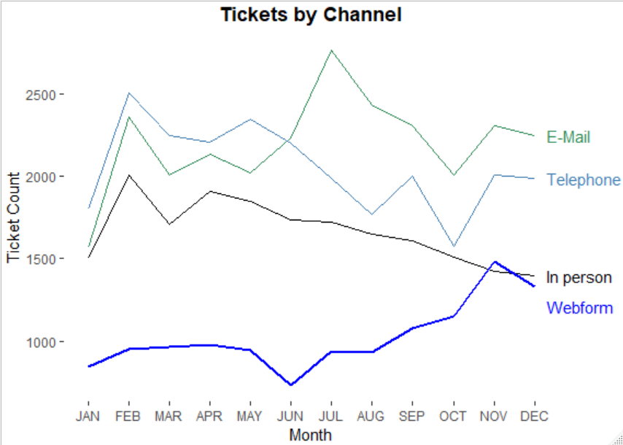
Tickets by Channel:
E-Mail: Tickets increased significantly in summer, then declined as Webform tickets increased
Telephone: Tickets submitted by phone decreased significantly as E-Mail and Webform tickets increased
In person: Tickets submitted by In person decreased significantly as E-Mail and Webform tickets increased
Webform: Webform tickets increased as the system became more popular. It was slow to take off, but is clearly becoming the most popular channel

Slide 6
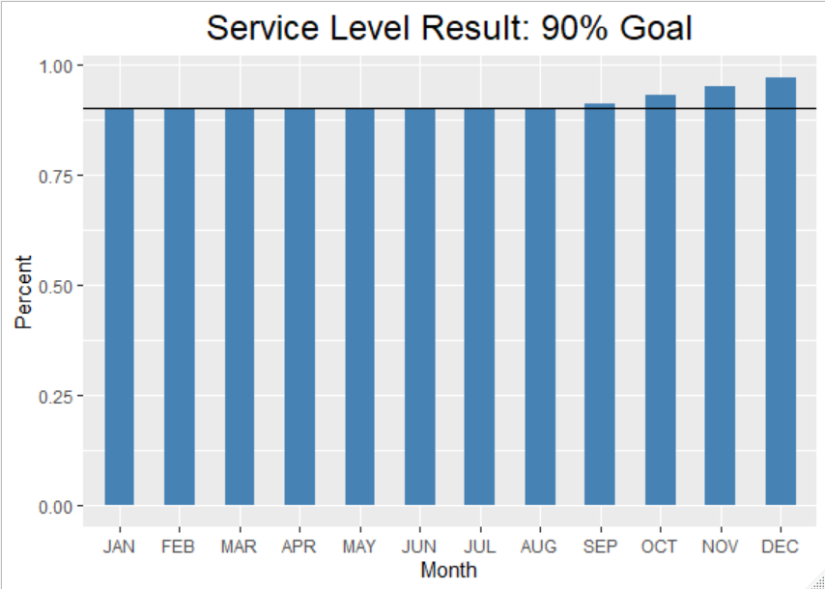
Percent of Service Level Goal: Option 1
The service level agreement goal of 90 percent has been met or exceeded every month since August. The service level achieved for December was 97 percent

Slide 7
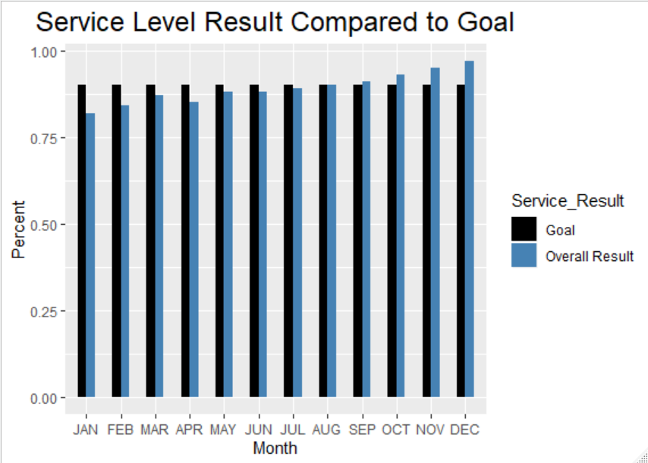
Percent of Service Level Goal: Option 2
The service level agreement goal of 90 percent has been met or exceeded every month since August. The service level achieved for December was 97 percent

Slide 8
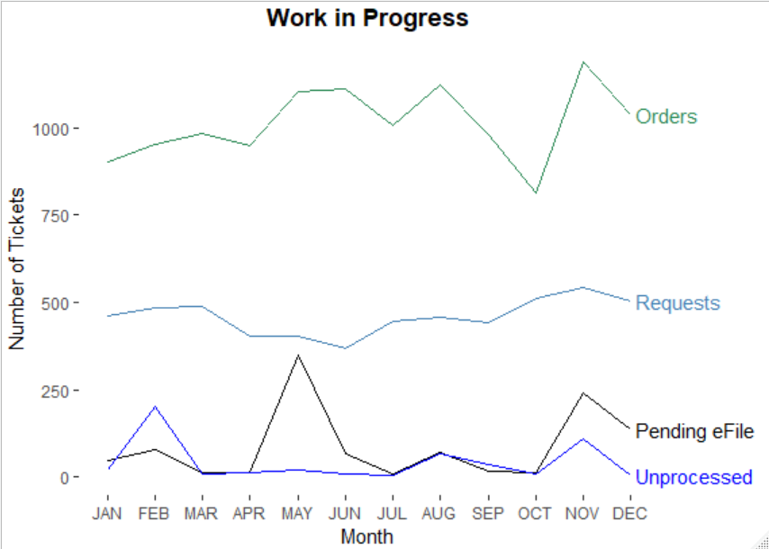
Work in process inventory
Orders: Orders dropped in October but have since increased to a mean level
Requests: Requests have held constant, with a slight increase in November
Pending efile: There was a backlog in May, and November and December also have higher than normal levels of tickets pending efile
Unprocessed Inbox: There as a slight peak in November, but the number of unprocessed inbox, has been consistently low

Slide 9
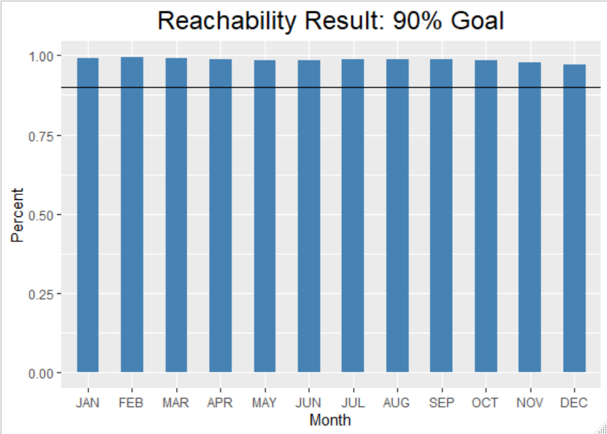
Reachability:
A reachability goal of 90 percent has been obtained every month

Slide 10
Reachability:
A reachability goal of 90 percent has been obtained every month

